Slide 1
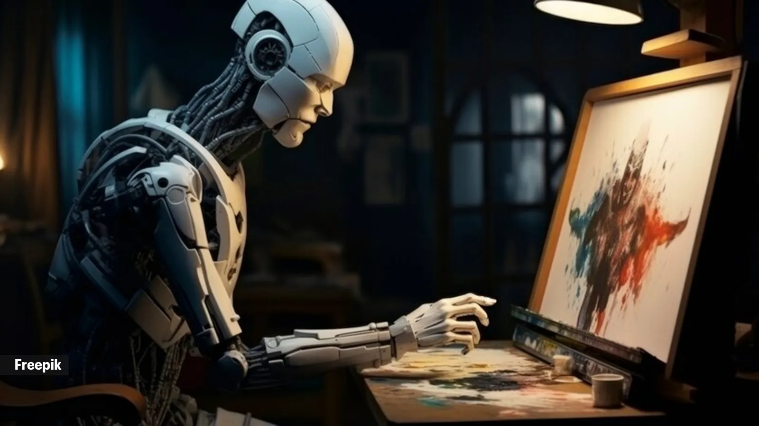
Detection of Art created by AI
Group 31
Aryan Sahu
Deep Zaveri
Anvita Lingampalli
Lakshmi Yogitha Puppala

Slide 2
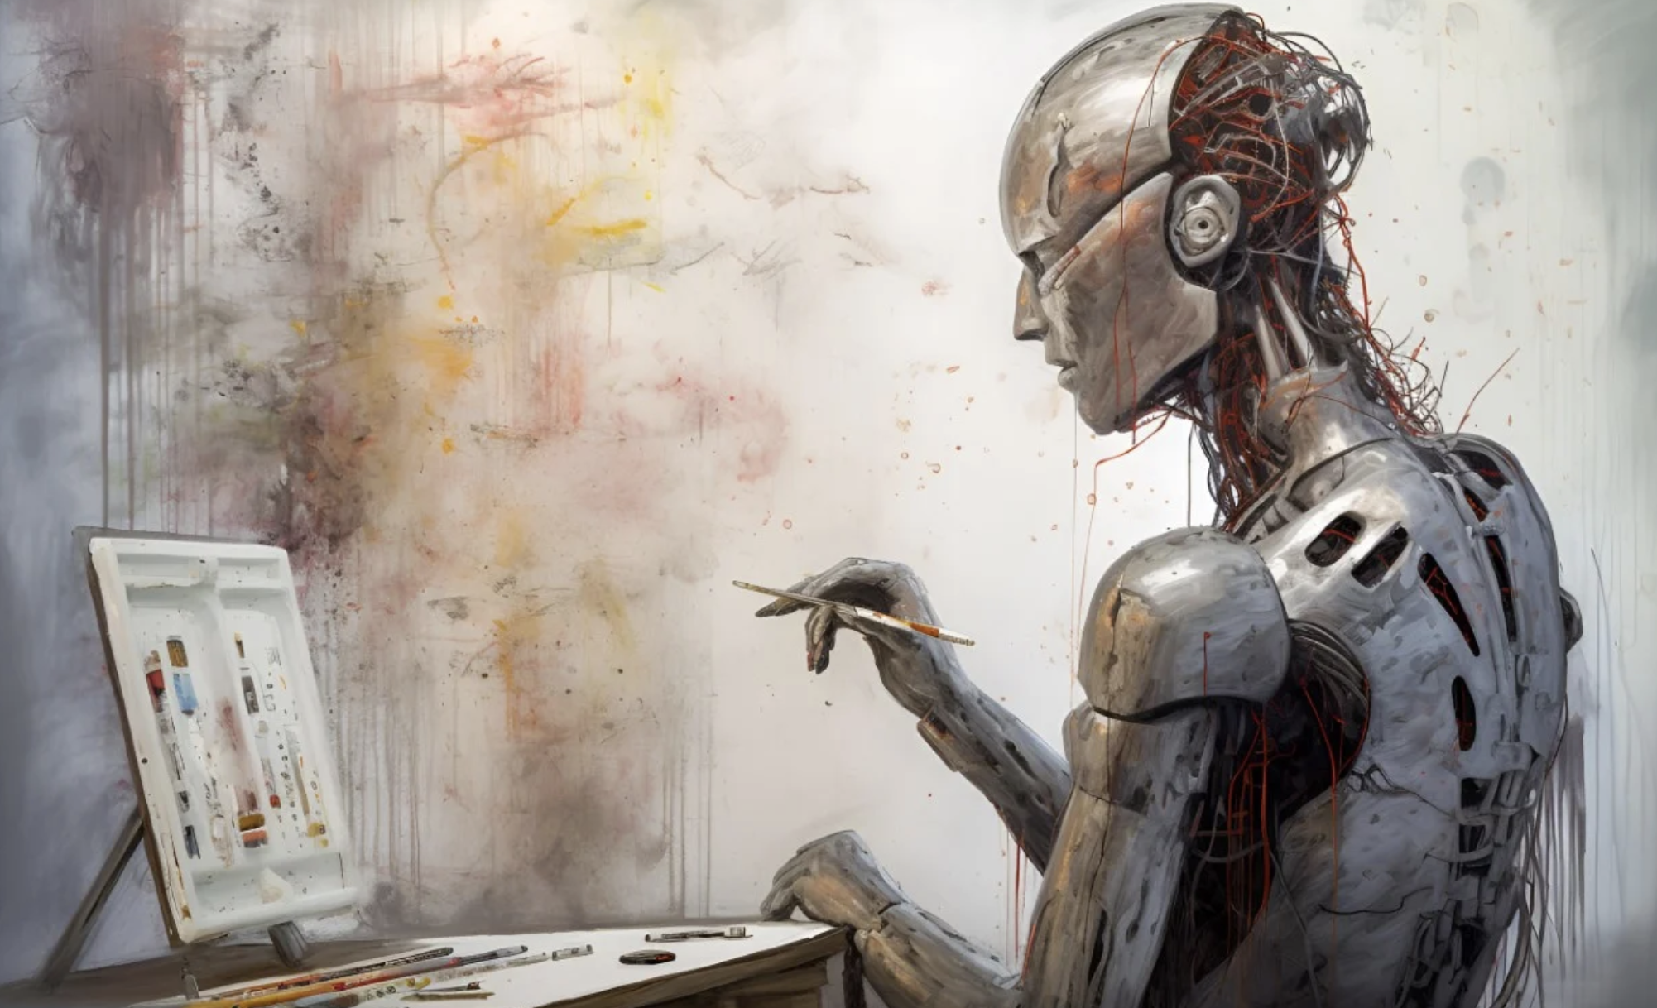
Problem Statement
The distinction between human and machine-generated art.
Ensuring the integrity of the art ecosystem
To create a dependable AI-based solution to handle these new issues.

Slide 3
Related Work
Previous studies in this field have identified several positive aspects along with drawbacks:
Strengths:
Thoroughly analyzing the issue by considering various factors like art styles, AI-generated image sources, different types of detectors, and countermeasures against adversarial attacks.
Weaknesses:
Previous research works explored the application of Deep Learning models, including VGG-19, ResNet-50.

Slide 4
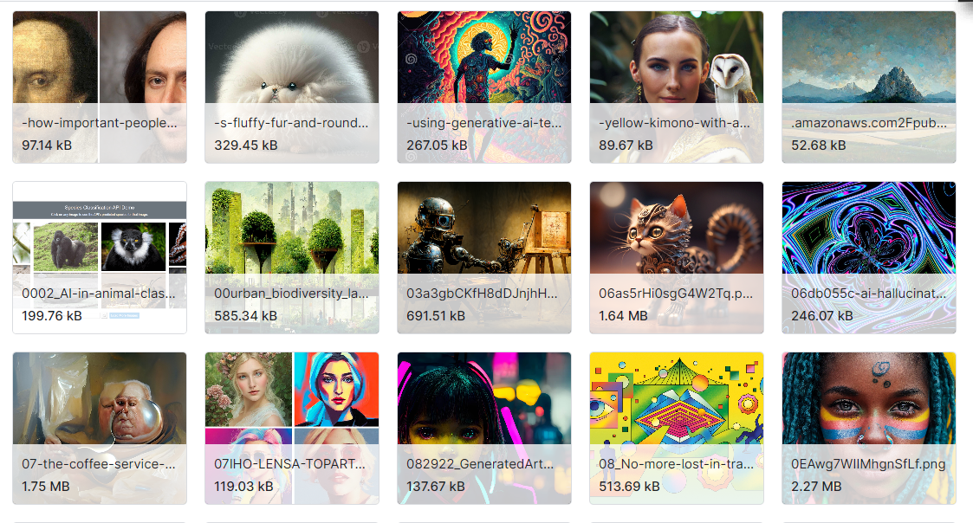
Dataset
Data source (link and reference) | https://www.kaggle.com/datasets/cashbowman/ai-generated-images-vs-real-images/data Source: Kaggle
Number of images | Total instances: 975 Ai Generated Images: 539 Real Art Images: 436
Dataset Split | Training: 80% Validation: 10% Testing: 10%

Slide 5
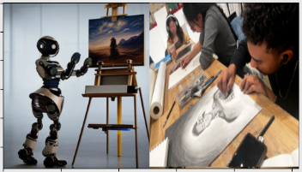
Models & Implementation
Used well-known deep learning methods to classify artwork.
Enhanced the capacity for model generalization by using data augmentation.
Investigated ResNet50 and Inception sophisticated network architectures.
Performance Comparison of VGG16, VGG19, Inception, and ResNet50.

Slide 6
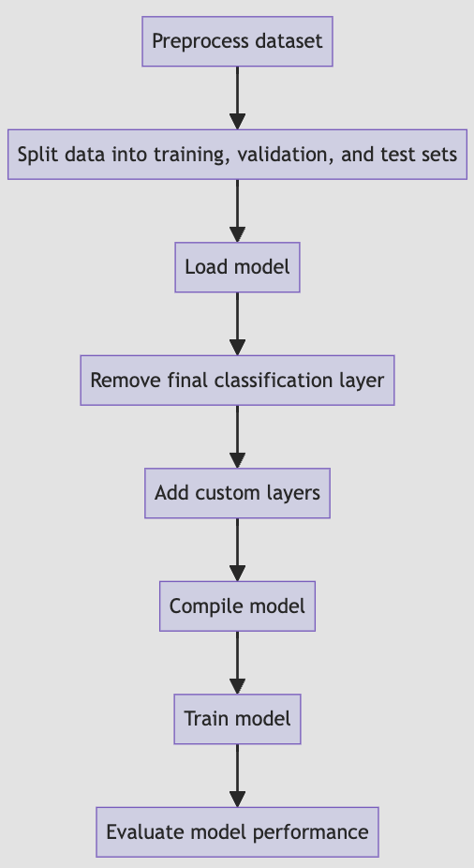
Experiment Design
The following steps were performed:
Preprocess Dataset: Perform any necessary resizing, normalization, and other modifications on the dataset of art images produced by AI and humans.
Split Data: The preprocessed dataset was divided into test, validation, and training sets.
Load model: Use the pre-trained model as a starting point.
Remove Final Classification Layer: Since we will be adding our own custom layers, remove the pre-trained model final classification layer.

Slide 7
Experiment Design
The following steps were performed:
5. Add Custom Layers: For binary classification, add custom layers such a global average pooling layer, a dense layer activated by ReLU, and a final dense layer activated by sigmoid.
6. Compile Model: Assemble the model using the proper optimizer, loss function, and metrics.
7. Train Model: Utilizing the training set, train the model, then track its results using the validation set.
8. Evaluate Model Performance: Analyze how well the training model performed using the test data.

Slide 8
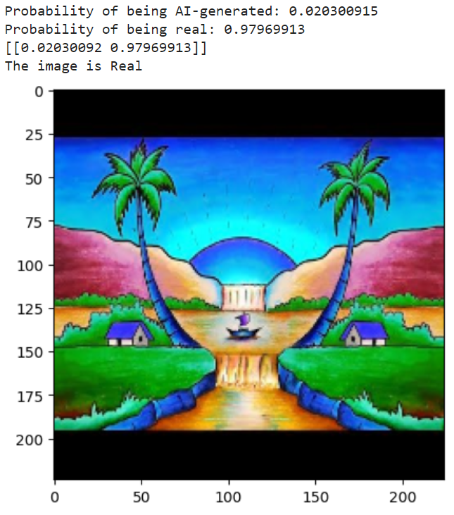
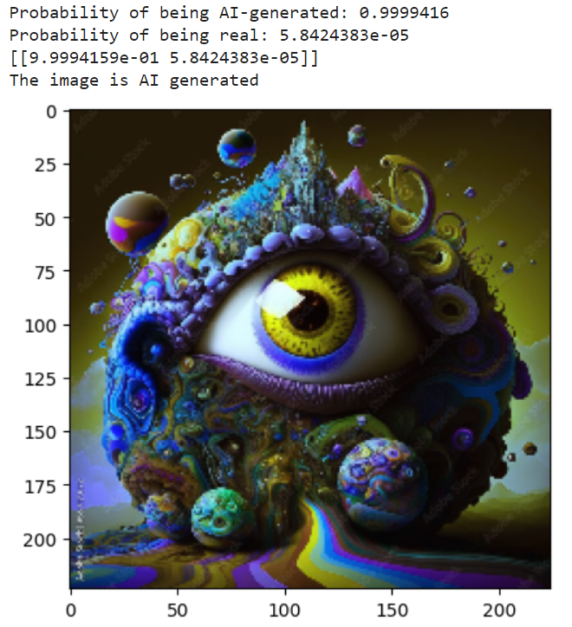
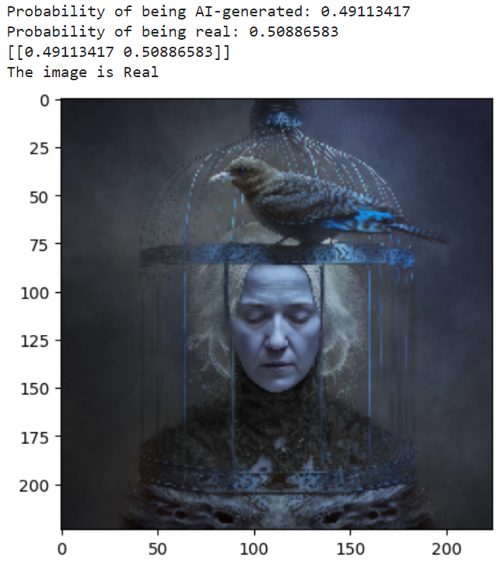
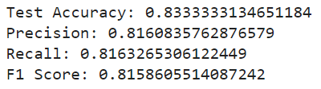
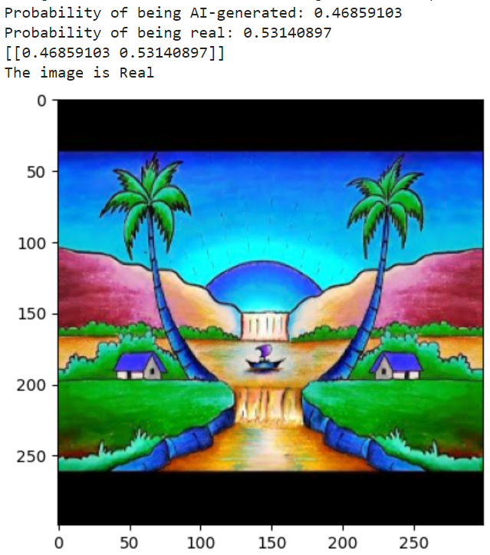
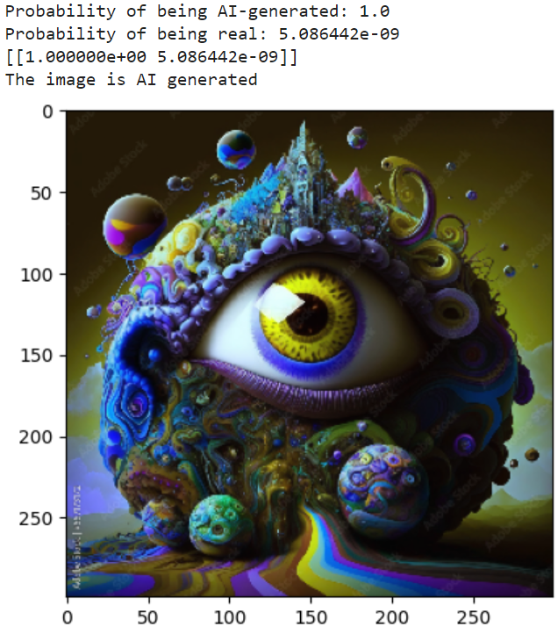
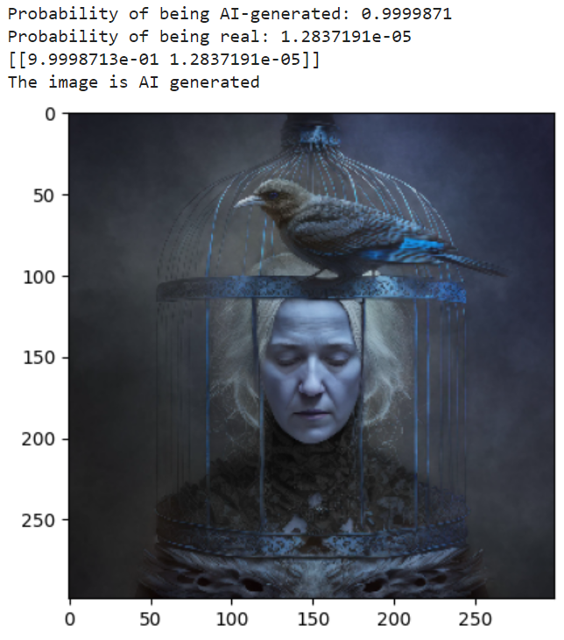
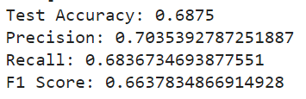
Results
Vgg16 Model
Inception Model

Slide 9
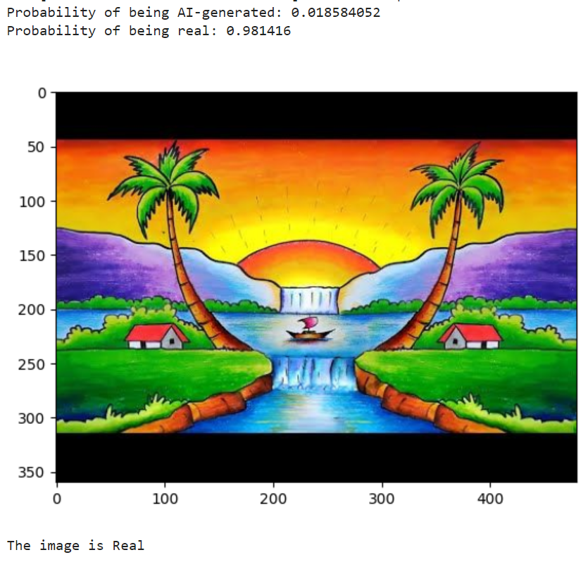
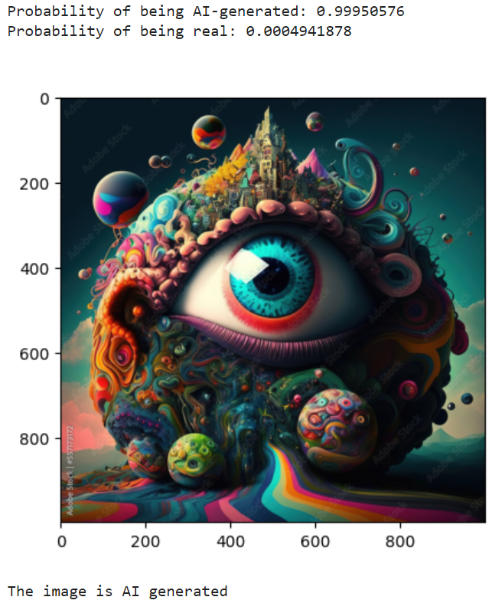
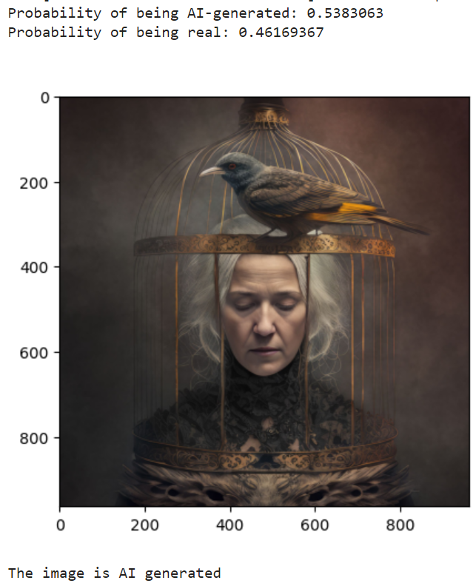
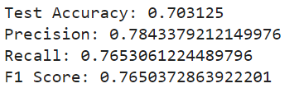
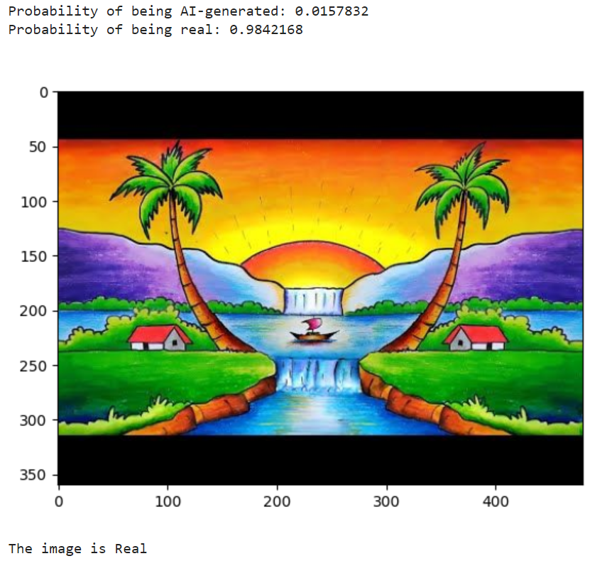
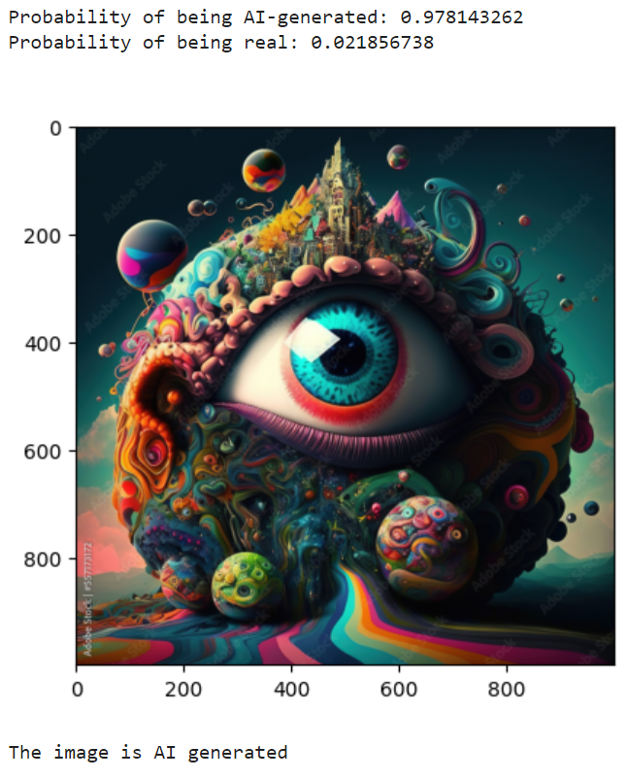
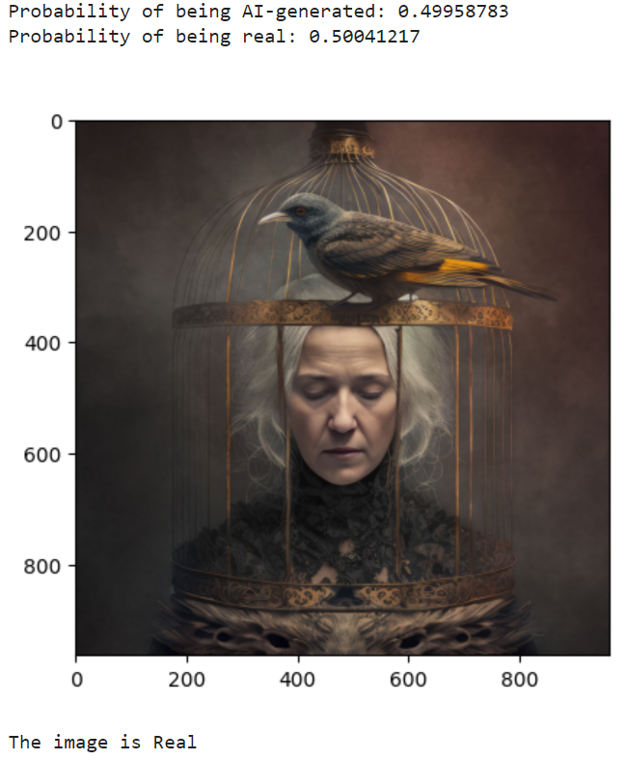
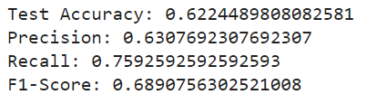
Results
Vgg19 Model
ResNet50 Model

Slide 10
Conclusion and Future Work
Conclusion: For the detection of Art created by Ai, VGG-16 gave the best test accuracy at around 83.33%.
Future Work:
Add newer AI-generated artwork
Work on newer and more accurate models.

Slide 11
Thank You!

